Slide 1
Concurrent applications
In early days most of computer applications were batch programs that are sequential and offline
Today applications are concurrent in which activities occuring in parallel
In concurrent applications incoming events is often not predictable and might be overlapping

Slide 2
Sequential and concurrent problems
Sequential-activities take place in sequence
Eg.A batch payroll application
Concurrent-activities take place in parallel
Eg.multiuser interactive system
Mapping concurrent activities to one sequential program leads to more complex design

Slide 3
Sequential and concurrent problems
A sequential application is a sequential program that consists of passive objects and has only one thread of control
When an object invokes an operation in another object, control is passed from the calling operation to the called operation
In concurrent application there are several active objects each with its own thread of control

Slide 4
The design concept of concurrent applications are generally applicable to real time and distributed applications

Slide 5
Real time systems and applications
sensor1
sensor2
sensor3
Real time system
actuator1
actuator2
actuator3

Slide 6
Embedded systems
Interaction with external environment
Timing constraints
Real-time control
Reactive systems
Hard real time and soft real time

Slide 7
Distributedsystem and applications
Improved availability
Flexible configuration
Localized control and management
Incremental system expansion
Reduced cost
Load balancing
Improved response time

Slide 8
Use case diagrams are behavior diagrams used to describe a set of actions (use cases) that some system or systems should or can perform in collaboration with one or more external users of the system (actors).
Each use case should provide some observable and valuable result to the actors or other stakeholders of the system.

Slide 9
Use case diagrams are used to specify:
(external) requirements on a subject, required usages of a system - to capture what a system under construction is supposed to do;
the functionality offered by a subject – what system can do;
requirements the specified subject poses on its environment - by defining how environment should interact with the subject so that it will be able to perform its services.

Slide 10
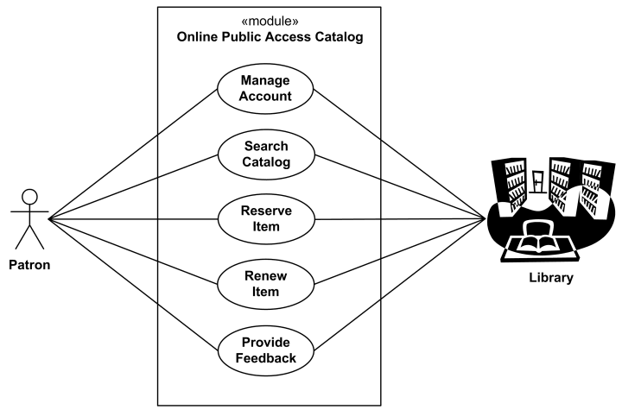
An Online Public Access Catalog (OPAC)

Slide 11
UML diagrams
Class diagram
Use case diagram
Behavior diagram
3.1 interaction diagram
3.1.1 sequence
3.1.2 collaboraion
3.2 state chart
3.3 Activity
4.Implementation diagram
4.1 component
4.2 deployment

Slide 12
Use case diagram
Graph of actors
Set of use cases enclosed by system boundaries
Communication associations between actors and the use cases and the generalisation among use cases

Slide 13
There are four kinds of relationships in the UML:
1. Dependency
2. Association
3. Generalization
4. Realization
These relationships are the basic relational building blocks of the UML.

Slide 14

Dependencies
A dependency is a semantic relationship between two things in which a change to one thing (the independent thing) may affect the semantics of the other thing (the dependent thing).

Slide 15
Association
Actors may be connected to use cases only by association. An association between an actor and a use case indicates that the actor and the use case communicate with one another, each one possibly sending and receiving messages.

Slide 16
Generalization
a generalization is a specialization/generalization relationship in which objects of the specialized element (the child) are substitutable for objects of the generalized element (the parent). In this way, the child shares the structure and the behavior of the parent.

Slide 17
In UML modeling, a generalization relationship is a relationship in which one model element (the child) is based on another model element (the parent). Generalization relationships are used in class, component, deployment, and use-case diagrams to indicate that the child receives all of the attributes, operations, and relationships that are defined in the parent

Slide 18


Slide 19
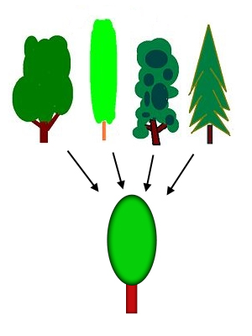
Generalization

Slide 20
Realization
use realization in two circumstances: in the context of interfaces and in the context of collaborations.
Most of the time, you'll use realization to specify the relationship between an interface and the
class or component that provides an operation or service for it. An interface is a collection of
operations that are used to specify a service of a class or a component.

Slide 21
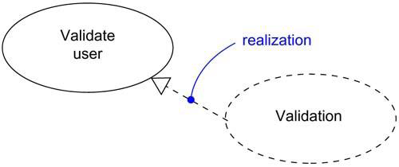
Realization of a Use Case

Slide 22
Include relationships
In UML modeling, an include relationship is a relationship in which one use case (the base use case) includes the functionality of another use case (the inclusion use case). The include relationship supports the reuse of functionality in a use-case model
Include relationships usually do not have names. If you name an include relationship, the name is displayed beside the include connector in the diagram.

Slide 23


Slide 24


Slide 25
Extend relationships
In UML modeling, you can use an extend relationship to specify that one use case (extension) extends the behavior of another use case (base). This type of relationship reveals details about a system or application that are typically hidden in a use case

Slide 26


Slide 27
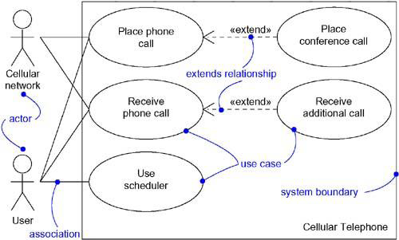

Slide 28
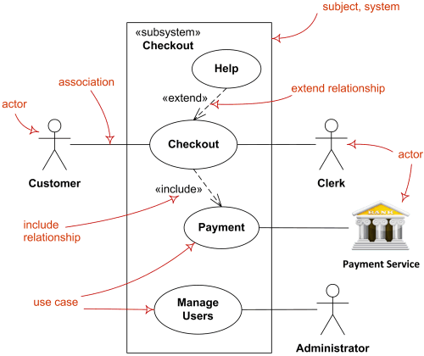

Slide 29
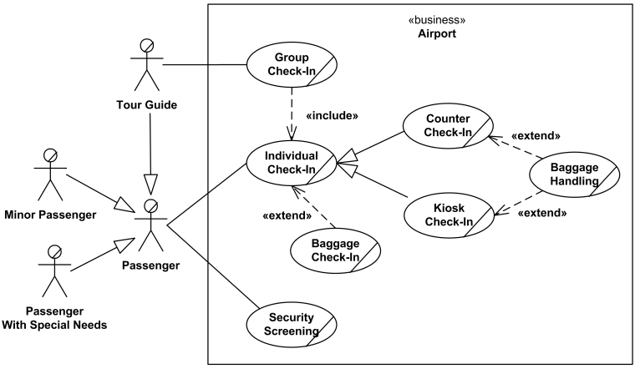
Airport Check-In and Security Screening

Slide 30
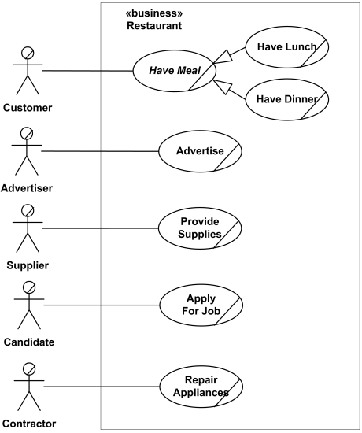
Restaurant

Slide 31
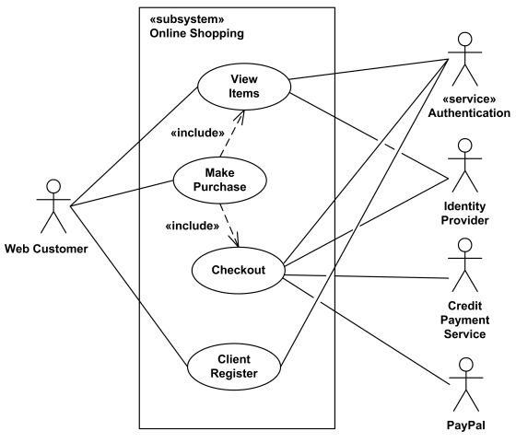
Online Shopping

Slide 32
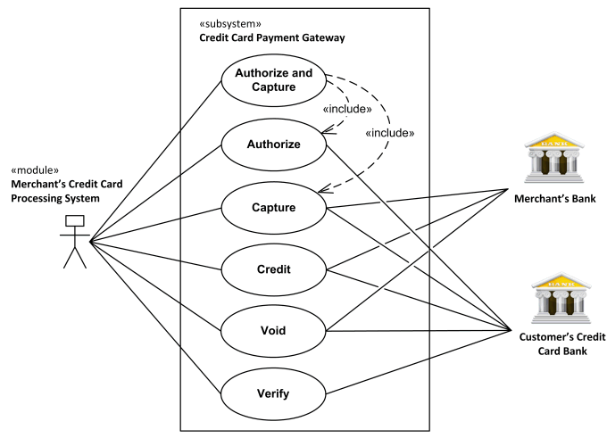
Credit Card Processing System

Slide 33
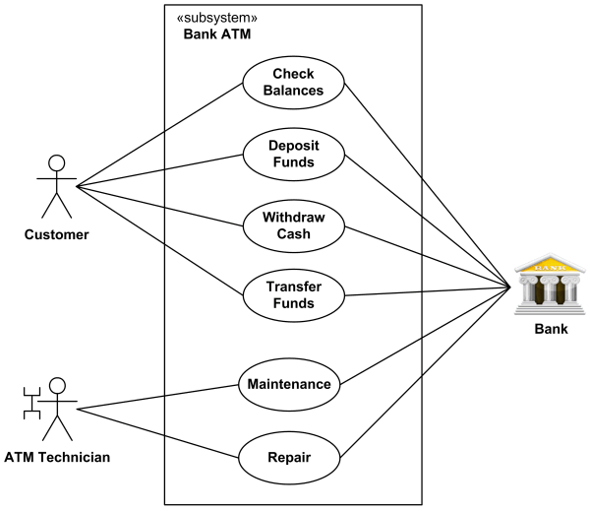
Bank ATM

Slide 34
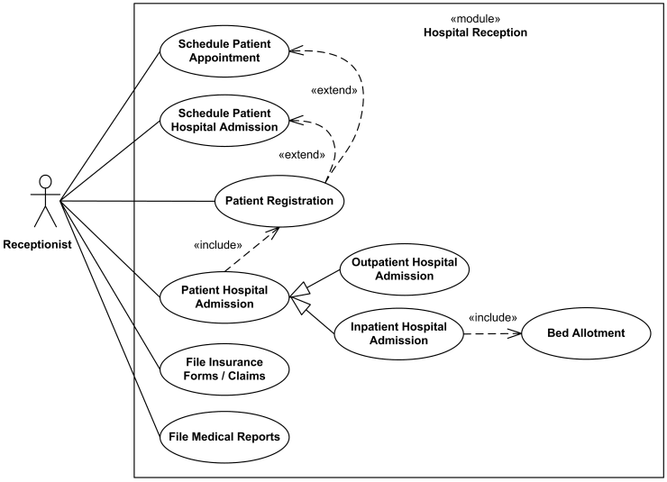
Hospital Management

